Slide 1
Voice to text
(Voice recognition)
Sixiang Zhang, Shaoxiang Zeng

Slide 2
Introduction
Our goal of this project is to make a voice recognition application which can generating subtitle when a voice is provided.

Slide 3
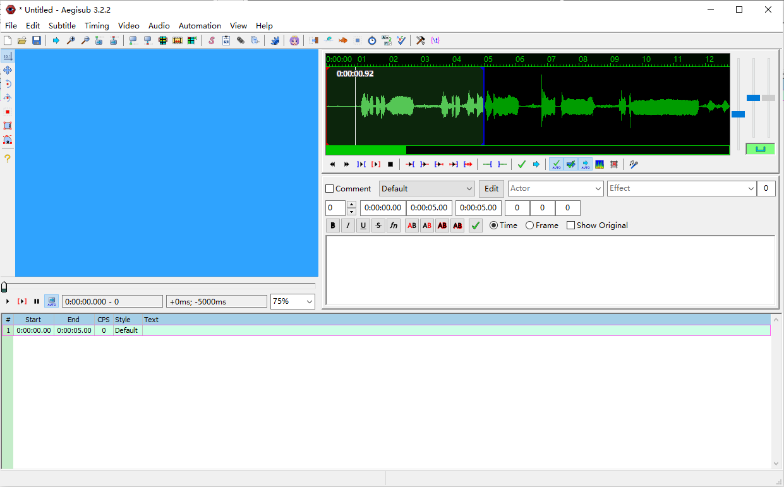
Why
Normal process: recognize a sentence, insert start and end time (takes too much time), then enter the subtitle
Our goal: Simplify this process with voice recognition, help individual youtuber/streamer/creator make subtitle efficiently

Slide 4


Key tools
Google SpeechRecognition API
Send audio file to Google, get the text (json) in return
Keras
The Python Deep Learning library
To develop our own model, instead of using Google API

Slide 5
Programming Tools and Backgrounds
Programming Language:
Python
System/Environment:
Windows
Tools may use:
PyCharm / Jupyter Notebook
Google Colab / Beocat（may be used for trainning model）

Slide 6
Challenges
Recognition time: need to catch up the speed of voice which is speaking, cannot be too slow.
The clarity of sound source: if the voice is not very clear, try to make guess of the voice.
Need large amounts of trainning files
Traning may need huge RAM

Slide 7
Plan and Tasks
Complete the basic voice to text function with google sppech recognition API (Feb)
A prototype console App based on Google Speech Recognition API (Mar)
Use Keras instead of Google API (Need to train the model by ourselves with Google Colab / Beocat) (Mar & April)
Further Development (GUI, Support for other language, Comparison between two APP) (April & May)
Testing, fix bugs, reports and final presentation (May)

Slide 8
Thanks

